Slide 1
What Not to wear: Speech & Debate Style

Slide 2
So, you’re competing at your first Speech tournament…
You’ve probably got a lot on your mind, like memorizing your speech, figuring out where you need to be and at what time…but what are you going to wear?

Slide 3
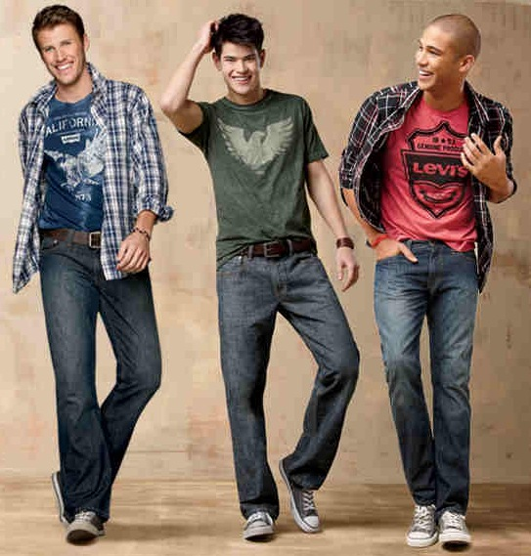
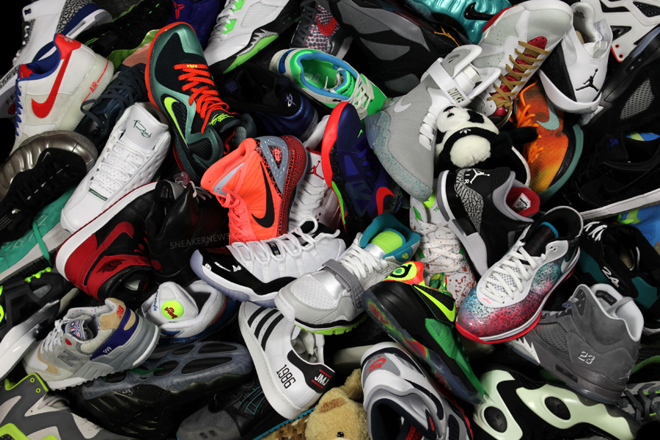
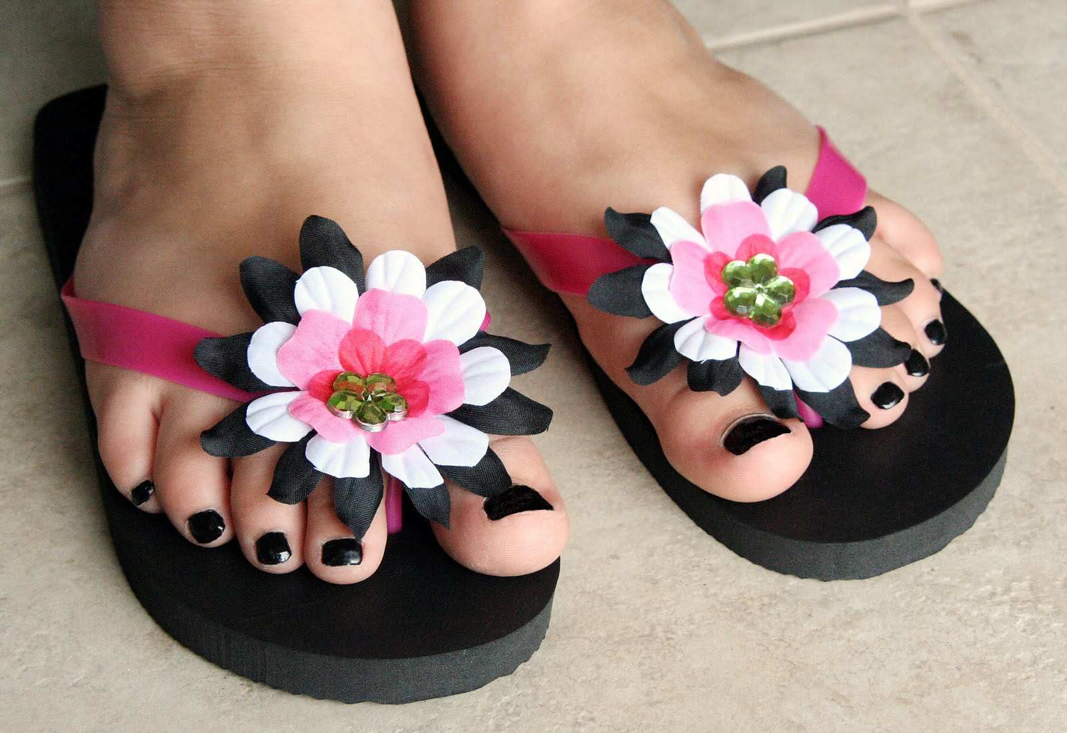
Don’t wear this…

Slide 4
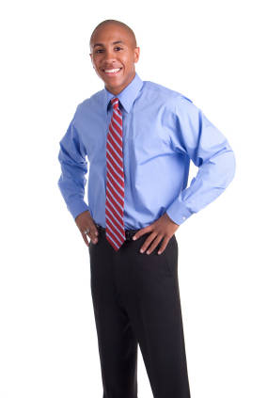
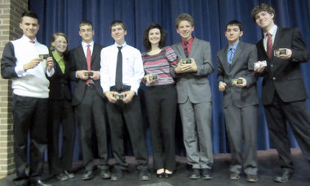
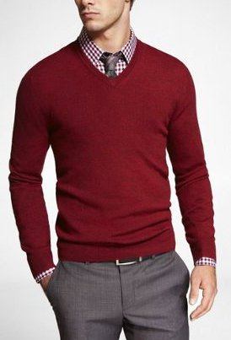
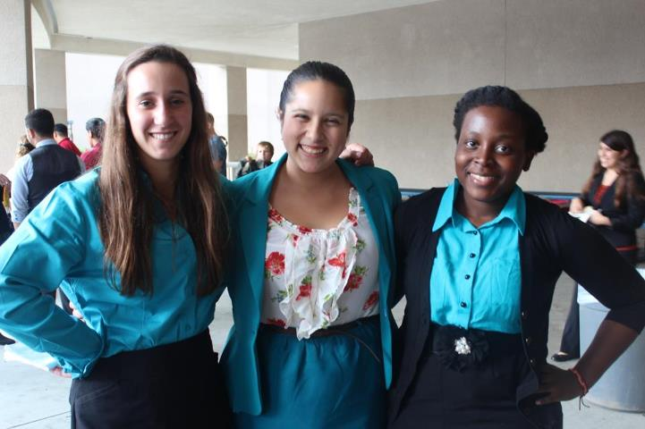
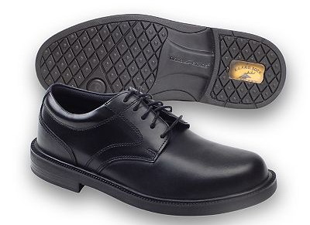
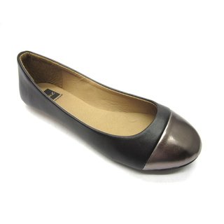
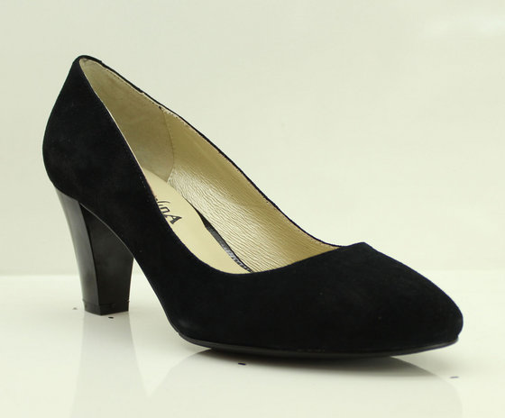
Wear something more like this…

Slide 5
Some more tips for picking your outfit
Always lean more professional & classic
Avoid clothing that is too trendy or flashy
Keep your event in mind
Interpers (especially in humor) can get away with wearing brighter colors—debaters tend to lean more neutral
Make sure it fits!
Can you move comfortably? Is it sagging where it shouldn’t be?
Make sure you look polished
No wrinkles, stains, holes.

Slide 6
When in doubt, ask!
Ms. M & the varsity team members want you to be successful! We’ve been there—we can help you out!

